Slide 1
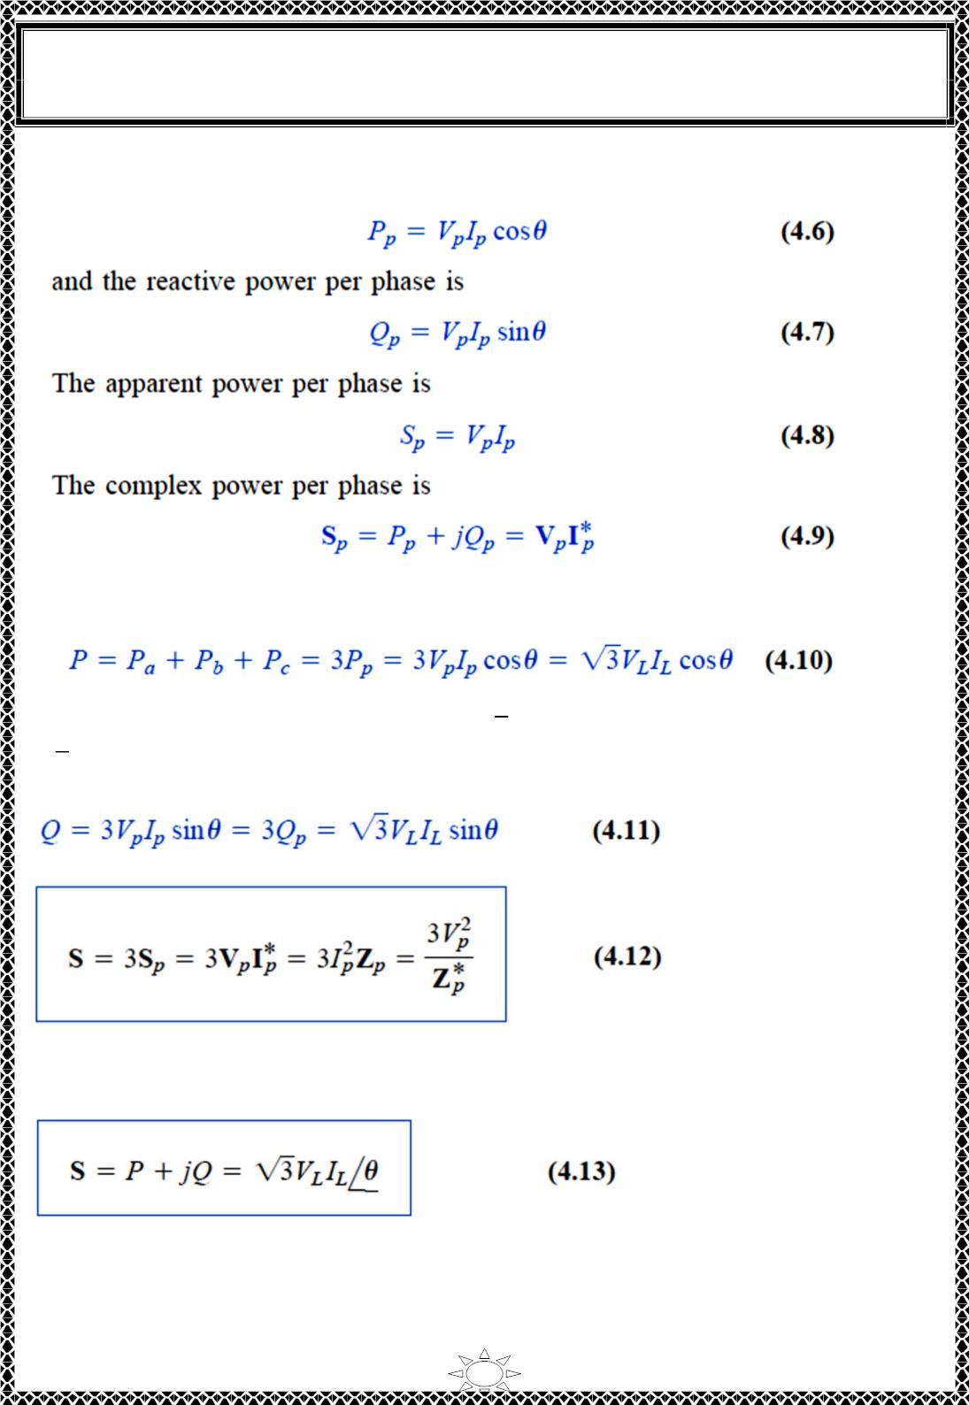
University of Diyala
Engineering College
Electronic Department
Electrical Circuits
2nd Class
Lecturer : Wisam N. AL-Obaidi
Year (2015-2016)
is independent of time, the average power per phase P_{p} for either the ∆-connected load or
the Y-connected load is p/3 or
where V and I are the phase voltage and phase current with magnitudes V and I
p
p
p
p
respectively. The total average power is the sum of the average powers in the phases:
Trail Version
Trail Version
Trail Version
Trail Version
Trail Version
Trail Version
Trail Version
Trail Version
Trail Version
Trail Version
Trail Version
Trail Version
Trail Version
For a Y-connected load, I = I but 푉 = √3 푉 whereas for a ∆-connected load, 퐼 =
L
p
퐿
푝
퐿
√3 퐼 but 푉 = 푉 . Thus, Eq. ( 4.10) applies for both Y-connected and ∆-connected loads.
푝
퐿
푝
Similarly, the total reactive power is
and the total complex power is
Where 푍 = 푍 ∠휃 is the load impedance per phase. (푍 could be 푍 or 푍 ). Alternatively,
푝
푝
푝
푌
∆
we may write Eq.(4.12) as
Remember that V , I , V and I are all rms values and that θ is the angle of the load
p
p
L
L
impedance or the angle between the phase voltage and the phase current.
A second major advantage of three-phase systems for power distribution is that the three-
phase system uses a lesser amount of wire than the single-phase system for the same line
21

Slide 2
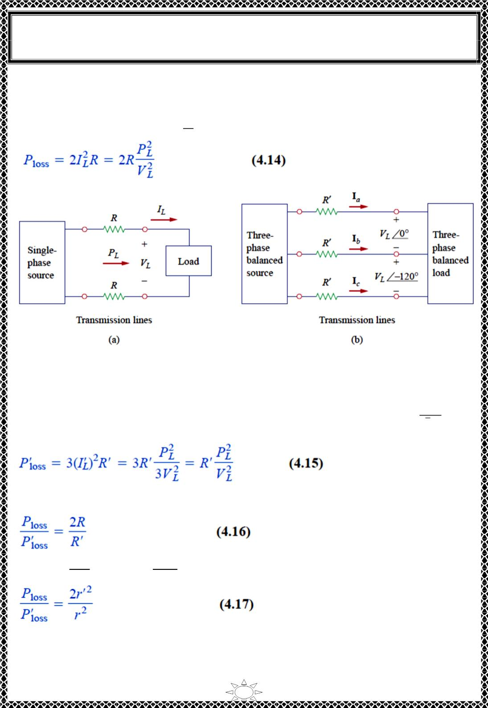
University of Diyala
Engineering College
Electronic Department
Electrical Circuits
2nd Class
Lecturer : Wisam N. AL-Obaidi
Year (2015-2016)
voltage V and the same absorbed power P . We will compare these cases and assume in
L
L
both that the wires are of the same material (e.g., copper with resistivity ρ), of the same
length ℓ, and that the loads are resistive (i.e., unity power factor). For the two-wire single-
^{푃}ꢀ
푉
ꢀ
phase system in Fig.4.1(a), 퐼_{퐿} = so the power loss in the two wires is
Trail Version
Trail Version
Trail Version
Trail Version
Trail Version
Trail Version
Trail Version
Trail Version
Trail Version
Trail Version
Trail Version
Trail Version
Trail Version
Fig.4.1 Comparing the power loss in (a) a single-phase system, and (b) a three-phase
system.
For the three-wire three-phase system in Fig.4.1(b), 퐼_{퐿}
′ = |퐼 | = |퐼 | = |퐼 | =
^{푃}ꢀ
√3 푉
from
Eq.(4.10). The power loss in the three wires is
푎 푏 푐
ꢀ
Equations (4.14) and (4.15) show that for the same total power delivered P_{L} and same line
voltage V_{L},
But 푅 =
휌ℓ
휋 푟²
and 푅′ =
휌ℓ
휋 푟ꢁ
. Where r and r' are the radii of the wires. Thus,
2
ꢃ
ꢃ
′
If the same power loss is tolerated in both systems, then ꢂ = ꢄ ꢂ . The ratio of material
required is determined by the number of wires and their volumes, so
22

Slide 3
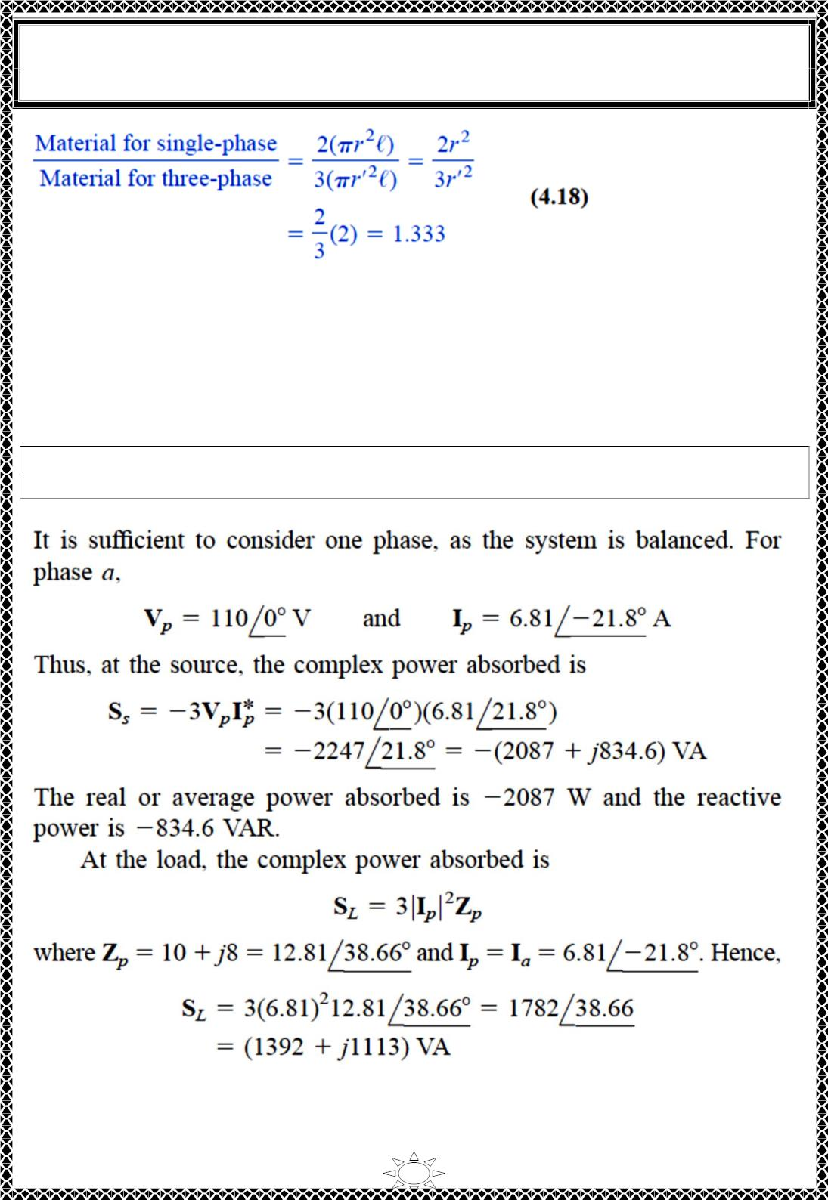
University of Diyala
Engineering College
Electronic Department
Electrical Circuits
2nd Class
Lecturer : Wisam N. AL-Obaidi
Year (2015-2016)
2
2
′
since 푟 = ꢀ 푟 . Equation (4.18) shows that the single-phase system uses 33 percent
more material than the three-phase system or that the threephase system uses only 75
percent of the material used in the equivalent single-phase system. In other words,
considerably less mate-rial is needed to deliver the same power with a three-phase system
than is .required for a single-phase system
Example 6: For Example2. Determine the total average power, reactive power, and
complex power at the source and at the load.
Solution:
Trail Version
Trail Version
Trail Version
Trail Version
Trail Version
Trail Version
Trail Version
Trail Version
Trail Version
Trail Version
Trail Version
Trail Version
Trail Version
23

Slide 4
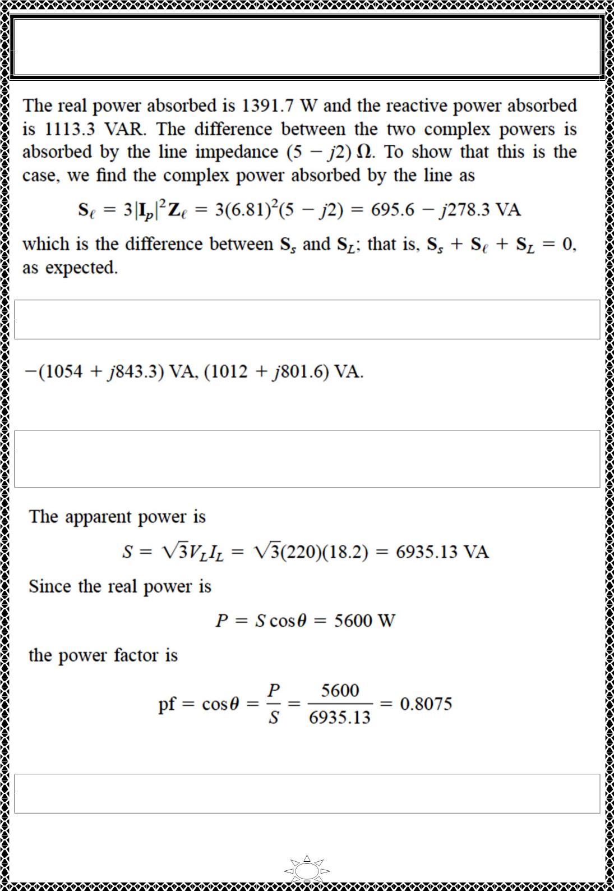
University of Diyala
Engineering College
Electronic Department
Electrical Circuits
2nd Class
Lecturer : Wisam N. AL-Obaidi
Year (2015-2016)
H.W.6: For the Y-Y circuit in H.W.2, calculate the complex power at the source and at
the load.
Answer:
Trail Version
Trail Version
Trail Version
Trail Version
Trail Version
Trail Version
Trail Version
Trail Version
Trail Version
Trail Version
Trail Version
Trail Version
Trail Version
Example 7:
A three-phase motor can be regarded as a balanced Y-load. A threephase
motor draws 5.6 kW when the line voltage is 220 V and the line current is 18.2 A.
Determine the power factor of the motor.
Solution:
H.W.7: Calculate the line current required for a 30-kW three-phase motor having a power
factor of 0.85 lagging if it is connected to a balanced source with a line voltage of 440 V.
Answer:
46.31 A.
24

Slide 5
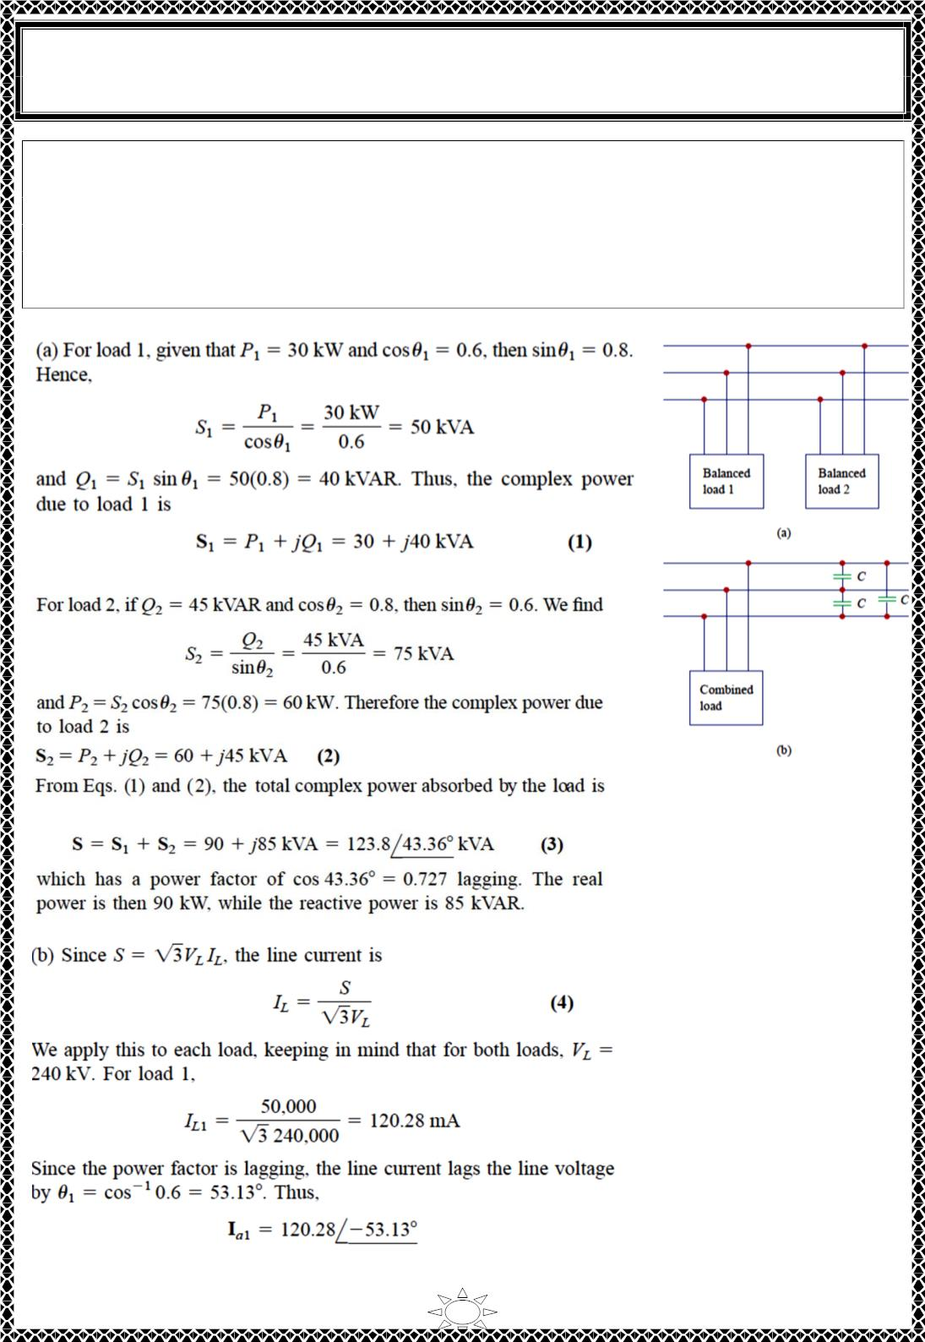
University of Diyala
Engineering College
Electronic Department
Electrical Circuits
2nd Class
Lecturer : Wisam N. AL-Obaidi
Year (2015-2016)
Example 8: Two balanced loads are connected to a 240-kV rms 60-Hz line, as shown in
Fig.(a). Load 1 draws 30 kW at a power factor of 0.6 lagging, while load 2 draws 45
kVAR at a power factor of 0.8 lagging. Assuming the abc sequence, determine: (a) the
complex, real, and reactive powers absorbed by the combined load, (b) the line currents,
and (c) the kVAR rating of the three capacitors ∆-connected in parallel with the load that
will raise the power factor to 0.9 lagging and the capacitance of each capacitor.
Solution:
Trail Version
Trail Version
Trail Version
Trail Version
Trail Version
Trail Version
Trail Version
Trail Version
Trail Version
Trail Version
Trail Version
Trail Version
Trail Version
25

Slide 6
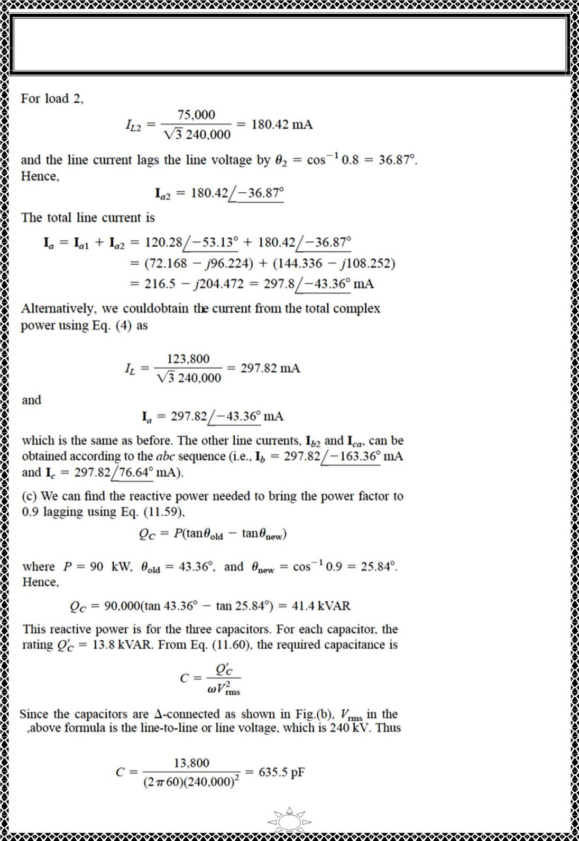
University of Diyala
Engineering College
Electronic Department
Electrical Circuits
2nd Class
Lecturer : Wisam N. AL-Obaidi
Year (2015-2016)
Trail Version
Trail Version
Trail Version
Trail Version
Trail Version
Trail Version
Trail Version
Trail Version
Trail Version
Trail Version
Trail Version
Trail Version
Trail Version
26

Slide 7
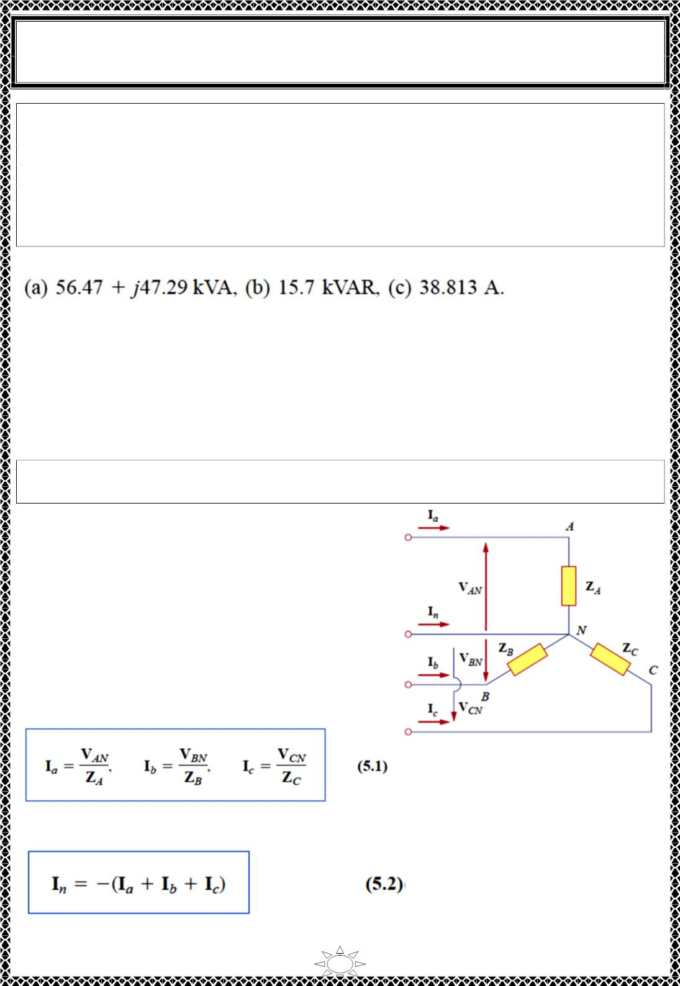
University of Diyala
Engineering College
Electronic Department
Electrical Circuits
2nd Class
Lecturer : Wisam N. AL-Obaidi
Year (2015-2016)
H.W.8: Assume that the two balanced loads in Fig.(a) for Example 8 are supplied by an
840-V rms 60-Hz line. Load 1 is Y-connected with (30 + j40) Ω per phase, while load 2 is
a balanced three-phase motor drawing 48 kW at a power factor of 0.8 lagging. Assuming
the abc sequence, calculate: (a) the complex power absorbed by the combined load, (b) the
Kvar rating of each of the three capacitors ∆-connected in parallel with the load to raise
the power factor to unity, and (c) the current drawn from the supply at unity power factor
condition.
Answer:
5) Unbalanced Three-Phase Systems
An unbalanced system is caused by two possible situations:
(1) the source voltages are not equal in magnitude and/or differ in phase by angles that are
unequal.
(2) load impedances are unequal.
An unbalanced system is due to unbalanced voltage sources or an unbalanced
load.
Trail Version
Trail Version
Trail Version
Trail Version
Trail Version
Trail Version
Trail Version
Trail Version
Trail Version
Trail Version
Trail Version
Trail Version
Trail Version
To simplify analysis, we will assume balanced
source voltages, but an unbalanced load.
Unbalanced three-phase systems are solved by
direct application of mesh and nodal analysis.
Fig.5.1 shows an example of an unbalanced three-
phase system that consists of balanced source
voltages (not shown in the figure) and an
unbalanced Y-connected load (shown in the figure).
Since the load is unbalanced, Z , Z and Z are not
A
B
C
equal. The line currents are determined by Ohm’s
law as
Fig.5.1 Unbalanced three-
phase Y -connected load.
This set of unbalanced line currents produces current in the neutral line, which is not zero
as in a balanced system. Applying KCL at node N gives the neutral line current as
27

Slide 8
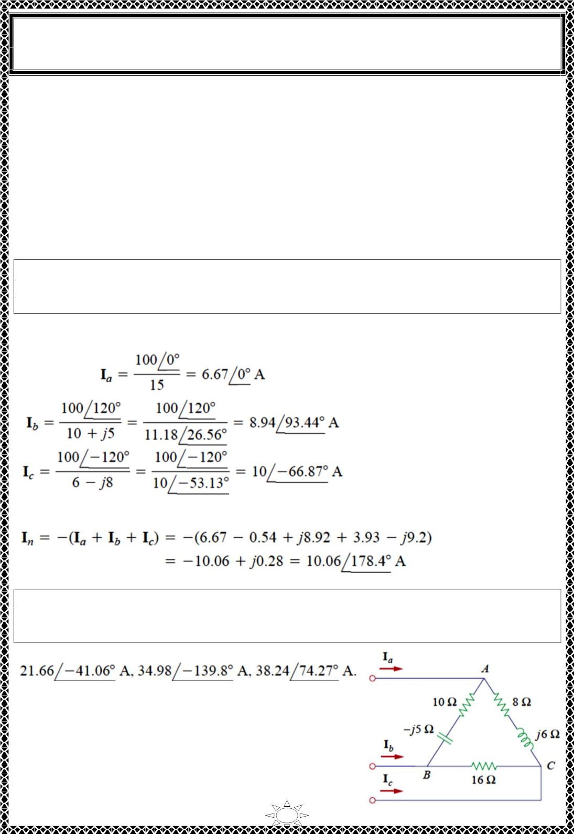
University of Diyala
Engineering College
Electronic Department
Electrical Circuits
2nd Class
Lecturer : Wisam N. AL-Obaidi
Year (2015-2016)
In a three-wire system where the neutral line is absent, we can still find the line currents Ia,
I and I using mesh analysis. At node N, KCL must be satisfied so that I + I + I = 0 in
b
c
a
b
c
this case. The same could be done for an unbalanced ∆ -Y, Y-∆ or ∆-∆ three-wire system.
As mentioned earlier, in long distance power transmission, conductors in multiples of
three (multiple three-wire systems) are used, with the earth itself acting as the neutral
conductor.
To calculate power in an unbalanced three-phase system requires that we find the power in
each phase using Eqs. (4.6) to (4.9). The total power is not simply three times the power in
one phase but the sum of the powers in the three phases.
Example 9: The unbalanced Y-load of Fig.5.1 has balanced voltages of 100 V and the acb
sequence. Calculate the line currents and the neutral current. Take , Z =15 Ω, Z = 10 +
j5 Ω , ZC = 6 - j8 Ω
Solution:
Using Eq.(5.1), the line currents are
A
B
Trail Version
Trail Version
Trail Version
Trail Version
Trail Version
Trail Version
Trail Version
Trail Version
Trail Version
Trail Version
Trail Version
Trail Version
Trail Version
Using Eq.(5.2), the current in the neutral line is
H.W.9: The unbalanced -load of Fig. shown is supplied by balanced line-to-line voltages
of 240 V in the positive sequence. Find the line currents. Take Vab as reference.
Answer:
28

Slide 9
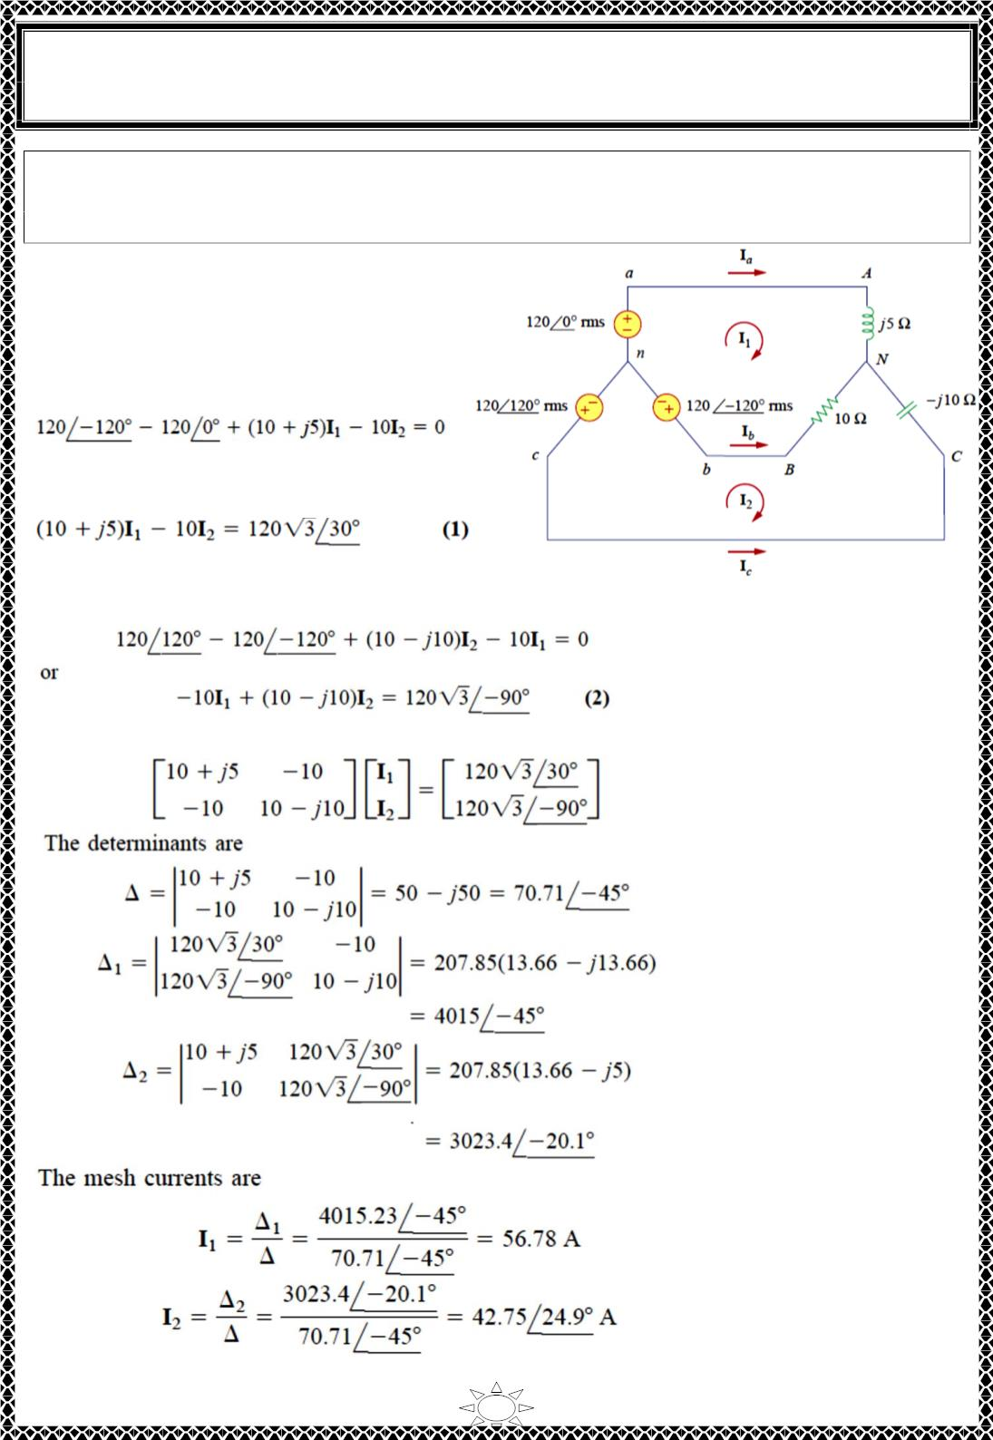
University of Diyala
Engineering College
Electronic Department
Electrical Circuits
2nd Class
Lecturer : Wisam N. AL-Obaidi
Year (2015-2016)
Example 10: For the unbalanced circuit in Fig. shown, find: (a) the line currents, (b) the
total complex power absorbed by the load, and (c) the total complex power absorbed by
the source.
Solution:
(a) We use mesh analysis to find the
required currents.
For mesh 1,
or
For mesh 2,
Trail Version
Trail Version
Trail Version
Trail Version
Trail Version
Trail Version
Trail Version
Trail Version
Trail Version
Trail Version
Trail Version
Trail Version
Trail Version
Equations (1) and (2) form a matrix equation:
29

Slide 10
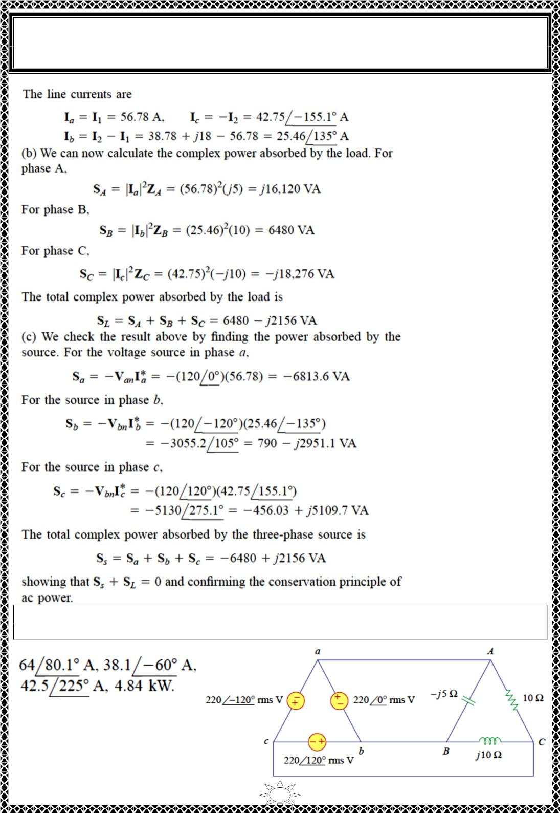
University of Diyala
Engineering College
Electronic Department
Electrical Circuits
2nd Class
Lecturer : Wisam N. AL-Obaidi
Year (2015-2016)
Trail Version
Trail Version
Trail Version
Trail Version
Trail Version
Trail Version
Trail Version
Trail Version
Trail Version
Trail Version
Trail Version
Trail Version
Trail Version
H.W.10: Find the line currents in the unbalanced three-phase circuit of Fig. shown and the
real power absorbed by the load.
Answer:
30

